Slide 1
Top-Level View of Computer Function and Interconnection
Yuemin Ding
Tecnun, University of Navarra
Fall, 2021

Slide 2
Outline
Computer components
Instruction fetch and execute cycles
Interrupts
Interconnection

Slide 3


Hardwired v.s. Software Systems
Everything that can be done in software can also be done in hardware!
Two different implementations to sense the colour of cards.

Slide 4
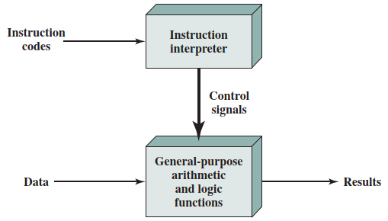
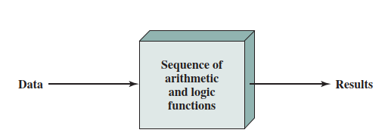
What do we still need software?
Hardwired systems are inflexible. It only accepts data and produces results.
Instead, we use:
General purpose hardware can do different tasks, given correct control signals.
Instead of re-wiring, supply a new set of control signals to general purpose hardware.
Hardwired programming
Software programming

Slide 5
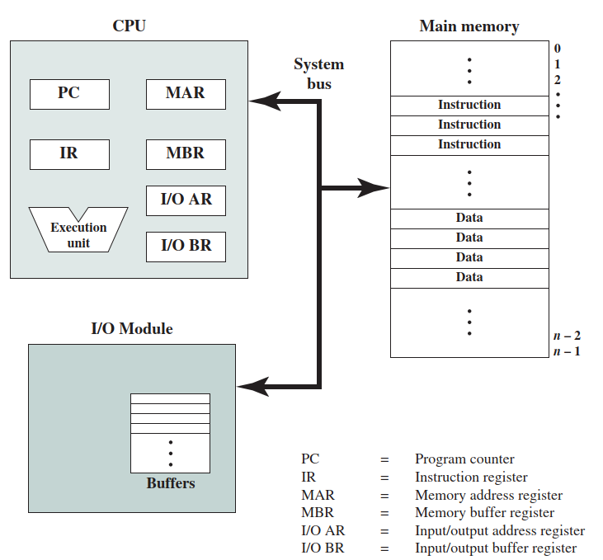
Components: Top Level View
Notes:
The Control Unit and the Arithmetic and Logic Unit (ALU) constitute the Central Processing Unit
Data and instructions need to get into the system and results out
Input/output
Temporary storage of code and results is needed
Main memory
An interconnection component is also needed
System bus

Slide 6
Outline
Computer components
Instruction fetch and execute cycles
Interrupts
Interconnection

Slide 7
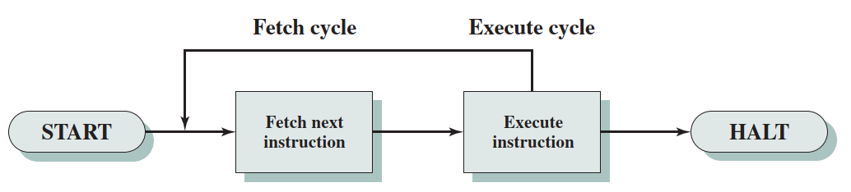
Instruction Fetch and Execute
The processing required for a single instruction is called an instruction cycle.
Instruction cycle include two steps:
Fetch cycle
Execute cycle

Slide 8
Fetch Cycle
Program Counter (PC) holds address of next instruction to fetch
Processor fetches instruction from memory location pointed to by PC
Increment PC
Unless told otherwise
Instruction loaded into Instruction Register (IR)
Processor interprets instruction and generated control signals to perform actions

Slide 9
Execute Cycle
Processor <-> memory
data transfer between CPU and main memory
Processor<->I/O
Data transfer between CPU and I/O module
Data processing
Some arithmetic or logical operation on data
Control
Alteration of sequence of operations
e.g. jump, if … else …
Combination of the above

Slide 10
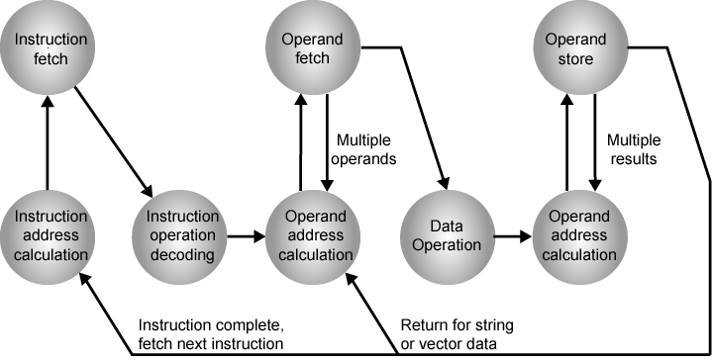
Instruction Fetch, Decode and Execute
Instruction address calculation (iac): Determine the address of the next instruction to be executed.
Fetch Decode Execute
Example: Add A,B →iac, if, iod, oac, of, oac, of, do, oac, os

Slide 11
Instruction Fetch, Decode and Execute
Instruction fetch (if): Read instruction from its memory location into the processor.
Fetch Decode Execute
Example: Add A,B →iac, if, iod, oac, of, oac, of, do, oac, os

Slide 12
Instruction Fetch, Decode and Execute
Instruction operation decoding (iod): Analyze instruction to determine type of operation to be performed and operand(s) to be used.
Fetch Decode Execute
Example: Add A,B →iac, if, iod, oac, of, oac, of, do, oac, os

Slide 13
Instruction Fetch, Decode and Execute
Operand address calculation (oac): If the operation involves reference to an operand in memory or available via I/O, then determine the address of the operand.
Fetch Decode Execute
Example: Add A,B →iac, if, iod, oac, of, oac, of, do, oac, os

Slide 14
Instruction Fetch, Decode and Execute
Fetch Decode Execute
Operand fetch (of): Fetch the operand from memory or read it in from I/O.
Example: Add A,B →iac, if, iod, oac, of, oac, of, do, oac, os

Slide 15
Instruction Fetch, Decode and Execute
Fetch Decode Execute
Example: Add A,B →iac, if, iod, oac, of, oac, of, do, oac, os

Slide 16
Instruction Fetch, Decode and Execute
Operand fetch (of): Fetch the operand from memory or read it in from I/O.
Fetch Decode Execute
Example: Add A,B →iac, if, iod, oac, of, oac, of, do, oac, os

Slide 17
Instruction Fetch, Decode and Execute
Data operation (do): Perform the operation indicated in the instruction.
Fetch Decode Execute
Example: Add A,B →iac, if, iod, oac, of, oac, of, do, oac, os

Slide 18
Instruction Fetch, Decode and Execute
Operand address calculation (oac): If the operation involves reference to an operand in memory or available via I/O, then determine the address of the operand.
Fetch Decode Execute
Example: Add A,B →iac, if, iod, oac, of, oac, of, do, oac, os

Slide 19
Instruction Fetch, Decode and Execute
Operand store (os): Write the result into memory or out to I/O.
Fetch Decode Execute
Example: Add A,B →iac, if, iod, oac, of, oac, of, do, oac, os

Slide 20
Outline
Computer components
Instruction fetch and execute cycles
Interrupts
Interconnection

Slide 21
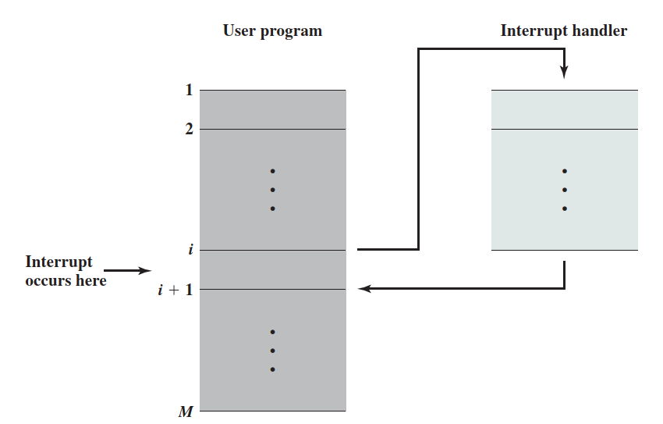
Interrupts
Mechanism by which other modules (e.g. I/O) may interrupt normal sequence of processing

Slide 22
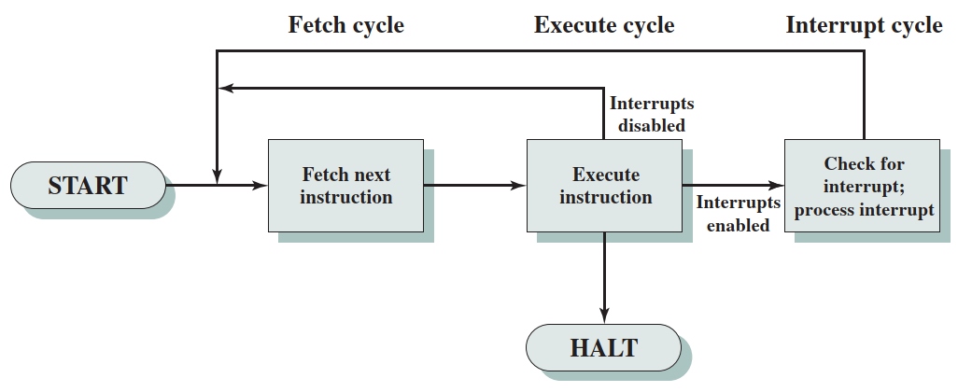
Interrupt Cycle
Interrupt cycle is added to instruction cycle
Without interrupt
With interrupt

Slide 23
Interrupt types
Types of Interrupts:
Program
e.g. overflow, division by zero
Timer
Generated by internal processor timer
Used in pre-emptive multi-tasking
I/O
from I/O controller
Hardware failure
e.g. memory parity error

Slide 24
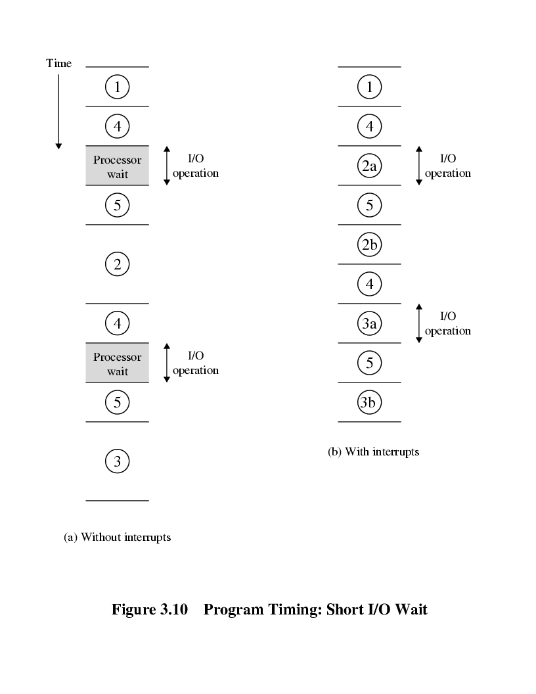
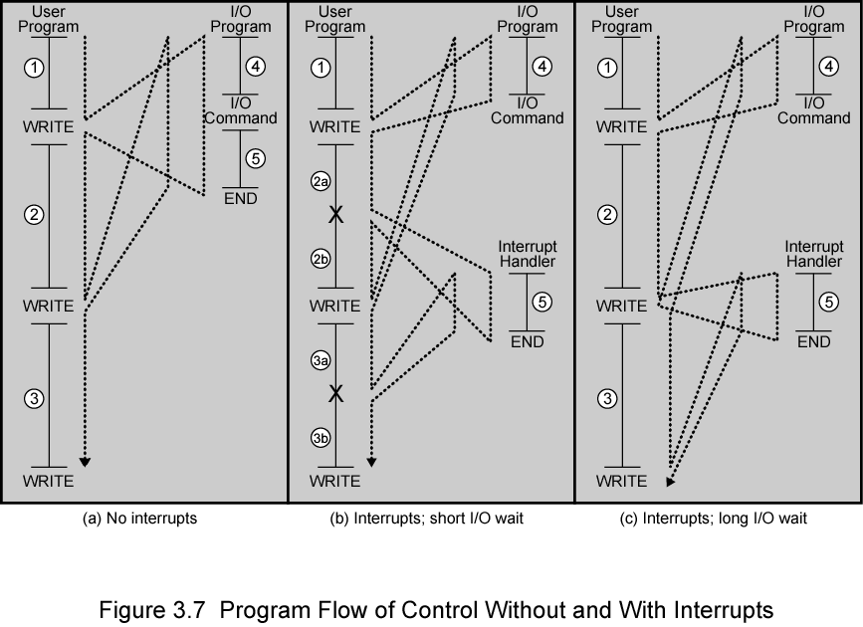
Program Timing - Short I/O Wait

Slide 25
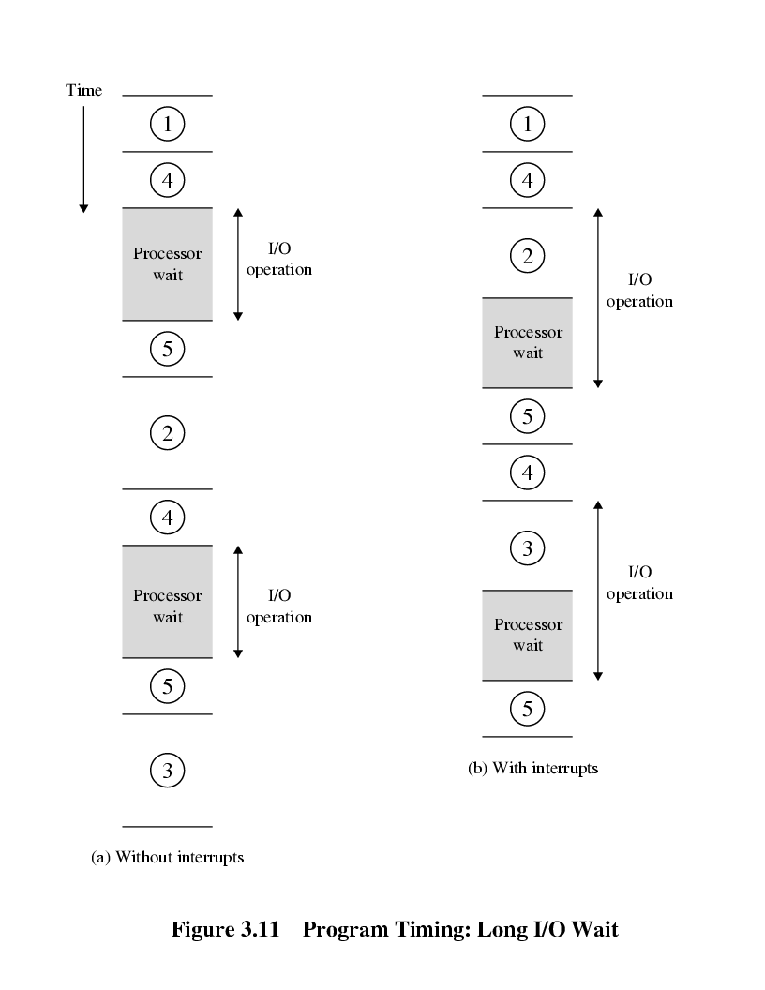
Program Timing - Long I/O Wait

Slide 26
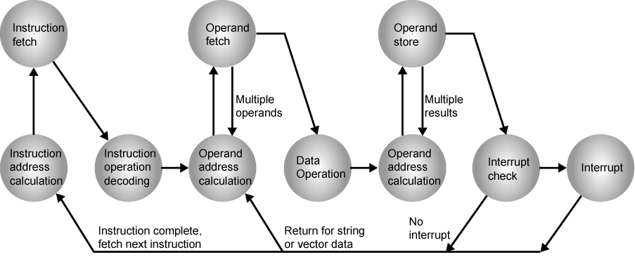
Instruction Cycle (with Interrupts) - State Diagram

Slide 27
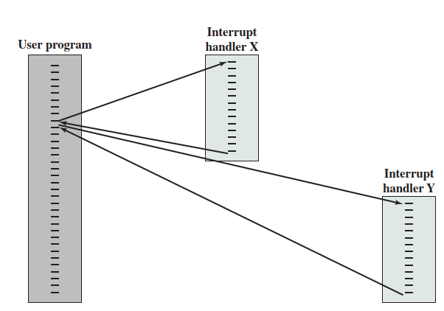
Multiple Interrupts-Solutions
Disable Multiple interrupts
Processor will ignore further interrupts whilst processing one interrupt
Interrupts remain pending and are checked after first interrupt has been processed
Interrupts handled in sequence as they occur

Slide 28
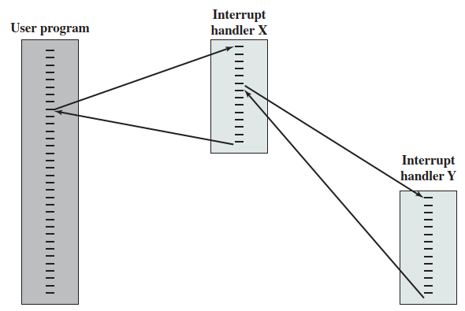
Multiple Interrupts-Solutions
Define priorities
Low priority interrupts can be interrupted by higher priority interrupts
When higher priority interrupt has been processed, processor returns to previous interrupt

Slide 29
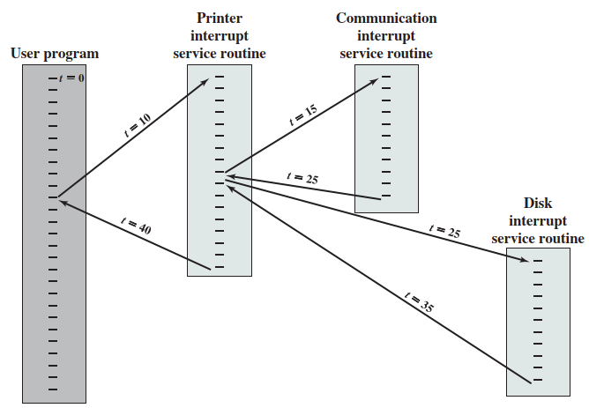
Time Sequence of Multiple Interrupts

Slide 30
Outline
Computer components
Instruction fetch and execute cycles
Interrupts
Interconnection

Slide 31
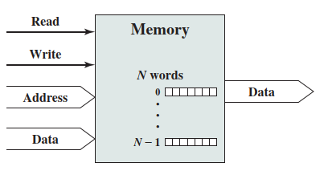
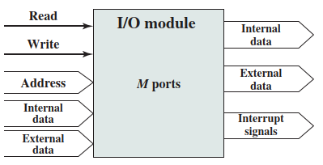
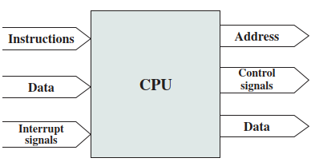
Interconnection Structures
All the units must be connected
Different type of connection for different type of unit
Memory
Input/Output
CPU

Slide 32
Memory <-> Processor
Processor → Memory
Control signals (e.g. Read/Write)
Address
Data
Memory → Processor
Instructions
Data

Slide 33
I/O <-> Processor
Processor → I/O
Control signals (e.g. Read/Write)
Address
Internal Data (e.g. stored file for printing)
I/O → Processor
Interrupt signals
Internal Data (e.g. keyboard signal)
I/O external signal
Input: mouse click
Output: monitor display

Slide 34
I/O <-> Memory
To improve performance of processor, I/O is allowed to exchange data directly with memory
This is realized with a secondary chip and the data exchange is not necessary to go through the processor.
I/O controler

Slide 35
Interconnection structures
In computer system, the most common interconnection structures are:
The bus and multi-bus structure
Point-to-point interconnection

Slide 36
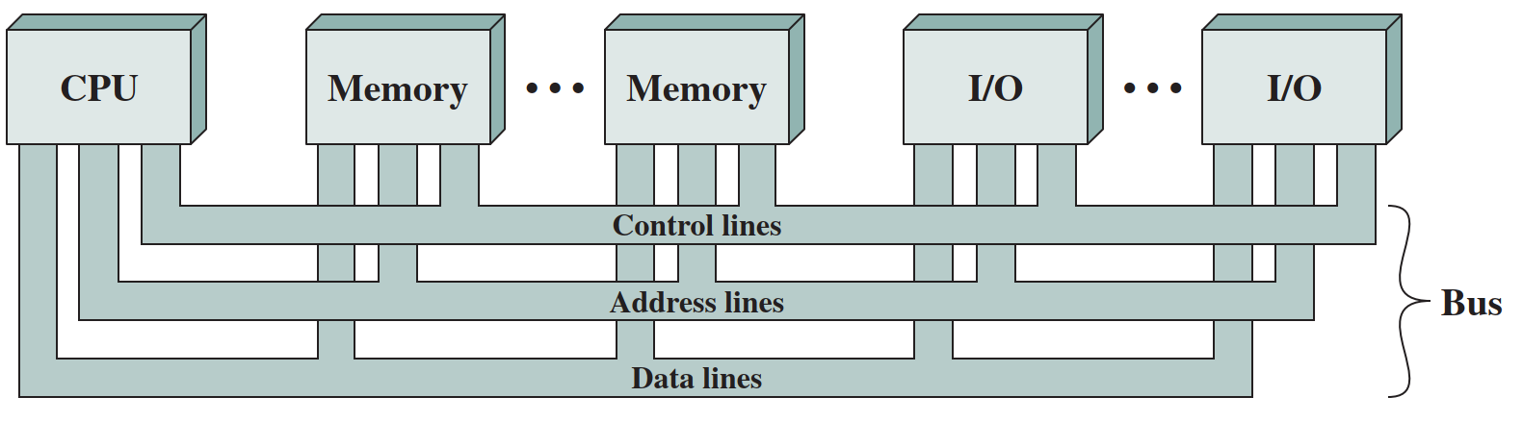
What is a Bus?
A communication pathway connecting two or more devices
A signal transmitted by any one device is available for reception by all other devices.
If two devices transmit during the same time period, their signals will overlap and become garbled.
Lines may be grouped for data transmission, e.g. 8, 16, 32, 64.

Slide 37
Data Bus
Carries data
Remember that there is no difference between “data” and “instruction” at this level
Width is a key determinant of performance
8, 16, 32, 64 bit
Data bus Width
…
A word in memory

Slide 38
Address bus
Identify the source or destination of data
e.g. CPU needs to read an instruction (data) from a given location in memory
Bus width determines maximum memory capacity of system
e.g. 8080 has 16 bit address bus giving 64k address space
0x0000
2¹⁶ = 64k
0x0001
…
…
0xFFFF

Slide 39
Control Bus
Control and timing information
Memory read/write signal
Interrupt request
Clock signals

Slide 40
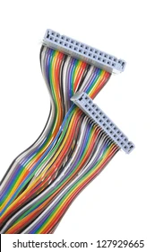
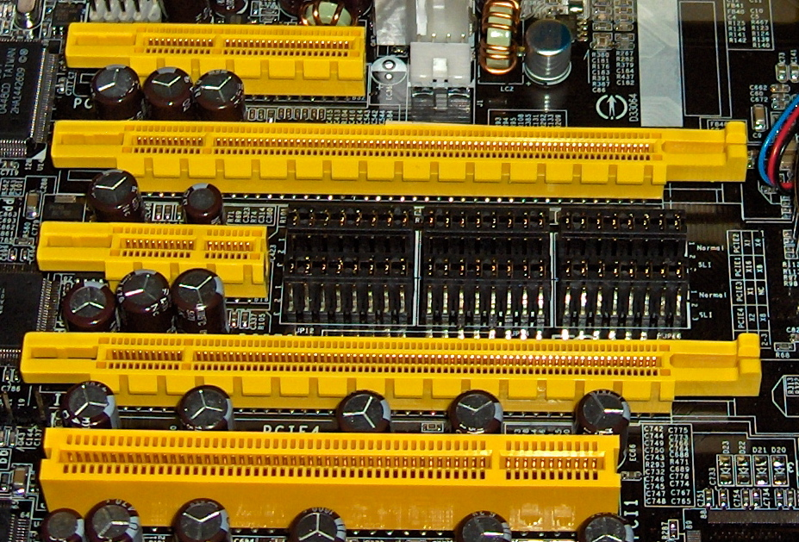
Buses in computer
What do buses look like?
Parallel lines on circuit boards
Ribbon cables
Strip connectors on mother boards
Sets of wires

Slide 41
Question 1
How does a CPU write a word into the memory cell with the bus system?

Slide 42
Question 2
How does an I/O inform the CPU that the data is ready with the bus system?

Slide 43
Single Bus Problems
Lots of devices on one bus leads to:
Propagation delays
Long data paths mean that coordination of bus use can adversely affect performance
Aggregated data transfer approaches bus capacity
Most systems use multiple buses to overcome these problems

Slide 44
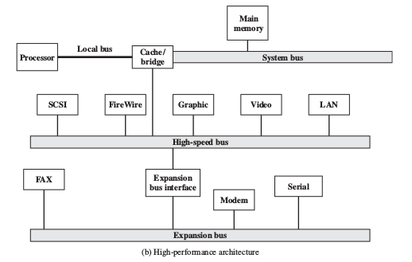
Multiple Buses
44

Slide 45
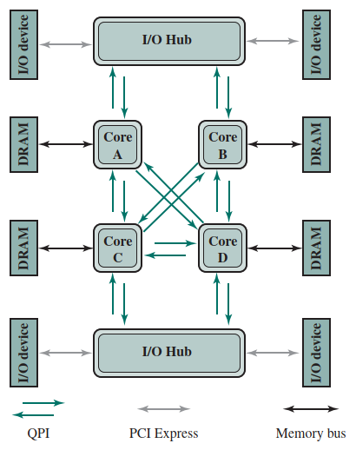
Point-to-Point Interconnect
The conventional bus encountered difficulties for higher and higher data rates due to electrical constraints.
Point-to-point connections (e.g. QPI and PCIe) can be established between each pair of cores and cores and I/O Hub.

Slide 46
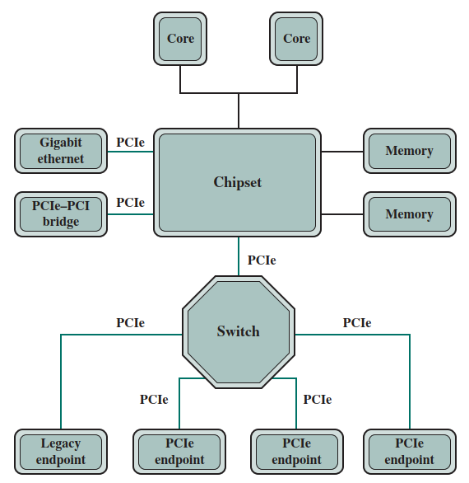
PCI Express
PCI Express is based on the Peripheral Component Interconnect (PCI), a high-bandwidth bus for high-speed I/O subsystems
PCIe has been developed as a point-to-point interconnection to keep pace with the high-rate demand of attached I/O device, such as Gigabit Ethernet.
QPI
Memory bus

Slide 47

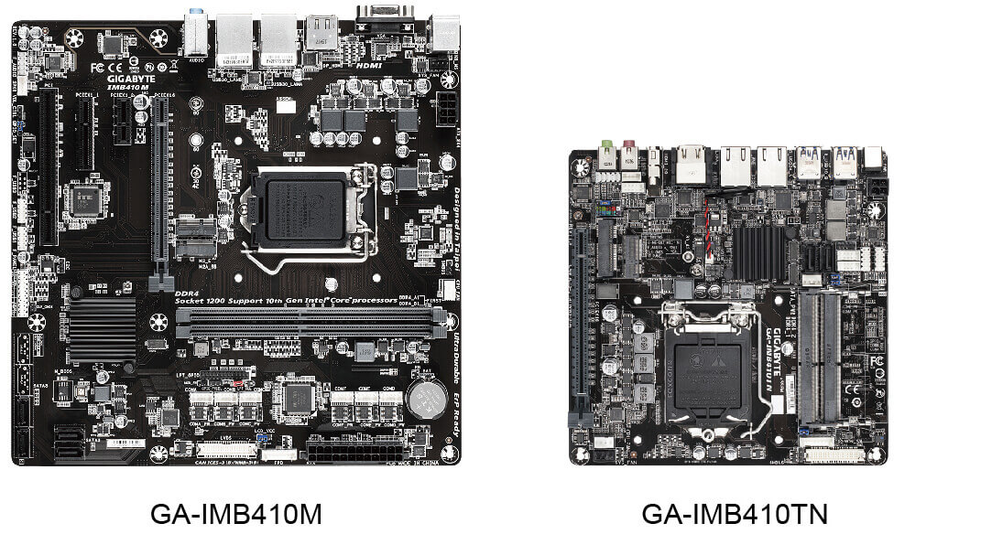
Interconnection of an Intel platform

Slide 48
Thank you! Q&A

